Slide 1


Blockchain for Academic Certification(As-Is Process)
Offline records of Certificates are not always reliable and can be easily morphed. Providing forged certificates to pursue higher education or employment is a crime and it was often observed.
Existing Solutions
Some large company or organization hire background check service provider company (Third Party Agencies) to outsource their all the verification tasks.
Digital Academic Credentials: A software for digital certification over Bitcoin Blockchain by MIT(click).
Statistics
● Gang of forgers sold 50,000 fake university degrees in New Delhi(click).
Short comes of Existing System
● The Maharashtra Medical Council(MMC) in Mumbai has busted a clutch of 57 doctors who submitted fake Post Graduation degrees(click).
Faking a paper-based educational certificate is easy.
Regenerating a certificate by the university has a lot of challenges.
Sixteen Post Graduation teachers obtained jobs with fake academic certificates in government-run schools of the state(click)

Slide 2
Solution Statement(To Be)
Proposed Solution
Building an app that issues and verifies blockchain-based records for academic credentials, professional certifications, workforce development, and civic records. The open standard ensures the longevity and interoperability of digital records
It becomes a time-saving process by removing the method of verifying the data through third party agencies.
Benefits of Solution
Fitment Of Technology
Blockchain will provide provenance, that is all the instances of the process involved in collecting the educational data.
Blockchain will serve as a standardized system for a digital certification by the university.
Blockchain will serve a single source of truth between the employee and the employer.
Blockchain will have the provenance of the information.

Slide 3
Blockchain for Crime Investigation(As-Is Process)
While logging any criminal cases, the digital pieces of evidence are also recorded manually over an offline manner which are not tampered proof .
Existing Solutions
The process of recording evidence is mostly offline where there is no much detailing recorded at different stages.
UK Gov’t Researching Distributed Ledger Technology for Securing Digital Evidence
(Source: Click)
Statistics
Police ‘mishandled’ evidence in the Pistorius murder case.
(Source: Click )
Short comes of Existing System
FBI agent in the evidence-tampering case.
(Source: Click )
Sometimes the pieces of evidence being in offline mode face traditional challenges like evidence sharing, identity management and ensuring citizens have maximum control over their own information, and it's hard to prove the authenticity of the evidence.
Lab Tech Annie Dookhan Faked Up To 60,000 Drug Sample Analyses.
(Source: Click )

Slide 4
Solution Statement(To Be)
Proposed Solution
To make a digitized system for recording digital evidence at a different levels, using blockchain. Here the hash of the evidence should be kept over the Blockchain and can be matched at a different stages or can be updated with respect to that hash at times.
It is possible to create accurate and sequential reconstructions of events to examine actions and determine how the current state of digital evidence came to be.
Benefits of Solution
Fitment Of Technology
Blockchain will provide all the updates that happened to the evidence.
Blockchain is an immutable ledger where things evidence once entered cannot be tampered.
Blockchain will serve as standardized system for recording updates at every level.
Blockchain will serve as single source truth for all the stack holder.
The smart contract will make sure the data entry at all the level.

Slide 5
Blockchain for Blockchain for tokenizing aspiring athletes (As-Is Process)
Sports have always seen a lot of talented players making money, but on the other hand we have seen that there is a serious lack of sponsorship for potential players.
Existing Solutions
Top companies sponsor a player when they represent at a recognizable level.
PlayerTokens – Tokenizing athletes for fan participation.
Statistics
Women’s sports sponsorships accounted for just 0.4% of all sports sponsorships (Source: Click )
Short comes of Existing System
Players are only sponsored when they have been recognized.
The companies take an unfair advantage of those players in terms of revenue sharing.
We saw so many articles/news that so many talented players are struggling to manage their lifestyles. Due to the lack of any reliable system which is unbiased and can provide the financial support to the players for their future.
Average earning of athletes at premier league (Source: Click )
The average Olympic athlete makes $20,000 a year, according to a 2016 estimate in TIME Magazine, which is not much when their annual sports-related expenses can run up to $25,000 a year (Source: Click )

Slide 6
Solution Statement(To Be)
Proposed Solution
A Blockchain based tokenizing platforms for athletes which allow investors to view an athlete’s tape and credentials and then provide immediate funds for a promise of some sort of future cut of the athlete’s earnings are embracing the blockchain to hold parties to their agreements.
Athletes can generate sponsorship from fans.
Benefits of Solution
Fans can get a return in terms of revenue sharing for the sponsorship to their favorite athletes.
Fitment Of Technology
Barriers for participation in a prominent sporting event for the athletes could be lowered.
Blockchain will provide provenance, that is all the instances of sponsored individuals.
Blockchain will serve a standardized system for sponsoring athletes.
Blockchain will serve a single source of truth between the fans and athletes.
Can generate more traction and awareness for unpopular sports events and individuals which can bring more sponsors.

Slide 7
Blockchain for carbon emission tracking (As-Is Process)
The consumption of carbon by individual and at communal level have reached an alarming level and there is a lack of adoption of renewable resources, which ultimately leads to environmental depletion.
Existing Solutions
Statistics
Carbon consumption to hit 40 billion metric tons around 2030(Source: Click )
Short comes of Existing System
In the current system, accounting is time-consuming and expensive, which can discourage the implementation of government policies.
No track of records for consumption of carbon by individuals and companies in a systematic order.

Slide 8
Solution Statement(To Be)
Proposed Solution
To tokenize energy credits using blockchain which can help in carbon offset credits to be more easily issued under government regulations. These credits can be purchased by companies and individuals for their purposes or used as a punitive measure for individual or for carbon consuming companies.
The token protocol will also be capable of automatically calculating how many carbon credits a company will need to purchase in order to sufficiently offset the calculated carbon footprint of a given product.
Tracking the carbon consumption and taking immediate measures on it will become much easier.
Benefits of Solution
The revenue generated by these energy tokens as part of a punitive measure can typically be reinvested for adoption renewable resources or to reduce carbon emissions in other ways. .
Fitment Of Technology
Blockchain will provide provenance, that is all the instances of utilizing their carbon credits.
Blockchain will serve a standardized system for distributing carbon credit.
Blockchain will serve a single source of truth between the companies consuming carbon credit and the governments.

Slide 9
Blockchain for agricultural product traceability(As-Is Process)
Every year, one-in-ten people fall ill - and 400,000 die - due to contaminated food.* Many of the critical issues impacting food safety such as cross-contamination, the spread of foodborne illness, unnecessary waste and the economic burden of recalls are magnified by a lack of access to information and traceability.
Existing Solutions
For keeping the records of food storage, each stockholder has adopted its own best-suited mechanism of record keeping. For example, some do it on the cloud and some do it on pen and paper.
IBM blockchain platform for food traceability.
Statistics
Horsemeat scandal in 2013: where 29% of horse meat in Tesco burger was untraceable for months(Source: Click )
Short comes of Existing System
Tracking the food takes an enormous amount of time.
Adulteration becomes easy when the supply chain is complex.
The World Health Organization estimates that one in ten people suffers from food poisoning worldwide, with 420,000 fatalities, each year (2017)(click).

Slide 10
Solution Statement(To Be)
Proposed Solution
It becomes a time-saving process by removing the method of verifying the data through third party agencies.
Building an app that verifies blockchain-based records for supply chain for food, it can be traced at harvest, at the packing shed, at wholesale markets and at retail outlets—to determine quality and marketability at each stage.
Benefits of Solution
It helps consumers to rely on the information and make them comfortable to pay for the rightful product.
Fitment Of Technology
Blockchain will provide provenance, that is all the instances of the process involved in collecting the information.
Blockchain will serve as a standardized system for record-keeping of supply-chain of food products.
Blockchain will serve a single source of truth between all the stakeholders involved.
Blockchain will have an immutable set of information.

Slide 11
Blockchain for Leasing a car (As-Is Process)
Leasing a car for some extra income is popularly in demand for the customers(dealers and buyers) its difficult to develop a trust between them. Sometimes dealers sells amassing cars or give wrong information about car, this cause lack of trust between both the parties.
Existing Solutions
People use to lease cars on their mutual understandings
Zoom Cars: Mobile app for leasing cars.
DocuSign: A Blockchained based car leasing company.
Statistics
Police recover 41 vehicles that had been taken from victims for leasing a car(Source: Click )
Short comes of Existing System
Faking the incurrence or other information
Selling of stole car is highly possible .
Faking the features like top speed, vehicle parts are easy.
2018, nearly 32 percent of new cars sold in the United States were leased. (click).

Slide 12
Solution Statement(To Be)
Proposed Solution
Making a blockchain based app for leasing cars where an individuals can list his car for rent without the involment of middleman and a buyer can verify the details related to it instantly.
Events can be triggred in the app if police department or incurrence company finds a car with same number.
Buyers can verify the features and other details easily.
Benefits of Solution
These self-executing contracts simplify the process with fewer intermediaries involved, and could also provide reminders or even garnish wages for those who fall into delinquency without the need for lawyers and debt collectors.
Fitment Of Technology
Blockchain will provide provenance, that is all the instances of car journey, features and incurrence.
Blockchain will serve a standardized system leasing a car.
Blockchain will serve a single source of truth between the dealers and the buyers.
Blockchain will make sure the enforcement of smart contract between the parties, which means their agreed terms and conditions.

Slide 13
Blockchain for Chit-fund (As-Is Process)
Chit-fund is one of the ways for a middle-class family for investing money for further growth. Many anonymous and untrusted Chit Fund Organizations may misuse public money and vanish.
Existing Solutions
In Traditional Chit fund Organizations, the total process of lending and borrowing money is connected through peer to peer network and is maintained manually by Traditional Chit fund Organizations, the total process of lending and borrowing money is connected through peer to peer network and is maintained manually by single-member i.e.,(ChitForeman).
Telangana Government has adopted with Blockchain-based platform to work on Chit Funds known as “T-Chits”.
Statistics
The Rose Valley Ponzi scam: Rs 15, 000 CR(Source: Click )
Short comes of Existing System
Foreman being a single authority to maintain records is not always reliable. Selling of stole car is highly possible .
Saradha Group chit fund scam, Rs 2460 CR (click).

Slide 14
Solution Statement(To Be)
Proposed Solution
The System of funding being an online process can be easily tracked compared to the traditional Chit Fund approach
The data related to the Chit Group and the Foreman can be viewed and shared by all the members of the group, thereby Fraud can be avoided and Trust factor can be built.
Benefits of Solution
Moreover, bidding becomes easy and the Chit Subscribers are committed to obeying the rules.
Fitment Of Technology
Time-saving and also fraud can be easily detected as the process is monitored by the entire chit group.
Blockchain will provide provenance, that is all the instances of the process involved in chit-fund.
Blockchain will serve as a standardized system for record-keeping of chit-fund data.
Blockchain will serve a single source of truth between all the stakeholders involved.
Blockchain will have an immutable set of information.
The entire Funding process runs Online.

Slide 15
Government Transfering Funds Over Blockchain(As-Is Process)
There is always a huge amount of funds being released by the government for development and welfare. But due to the involvement of middle man and too many protocols, in some cases, the promised value does not reach to victims or the beneficiaries.
Existing Solutions
Currently, funds are transferred from a central government or state government to the responsible welfare departments of the state and welfare department has the responsibility to distribute the amount to the beneficiaries and victims they have listed.
Statistics
India Today Expose: Skill India initiative weaves more scams than success stories.
(Source: Click)
Short comes of Existing System
The beneficiaries do not get the promised amount in some cases.
The process is too long and requires a lot of paperwork and time.
Tamil Nadu farmers get Rs 5, Rs 10 as compensation for crop loss.
(Source: Click )
Adarsh Housing Society scam.
(Source: Click )

Slide 16
Solution Statement(To Be)
Proposed Solution
Building a digitized record-keeping of funds over Blockchain, which will allow the government to easily transfer the funds directly to the beneficiaries and cutting down the risk of the middle man. This will allow keeping a record of issued and spending of funds at every stage; with their consent transactions are recorded on a distributed ledger
The process will take less time.
Benefits of Solution
The beneficiary will be credited directly without any risk of meddling man.
Fitment Of Technology
It was made easy to trace back and rectify if there was any human error.
Blockchain will provide a standardized way of record-keeping for the funds.
Blockchain will record all transaction happens in all the step, hence providing provenance.
Blockchain will serve as a single source of truth between the involved stakeholders.
The information related earlier transactions that have happened at every step, cannot be altered since its an append-only database.
The smart contract will trigger an automatic alert if something is taken out of scope.
The distribution of the fund will be transparent and can be traced back easily.

Slide 17
Blockchain implementation across various industries
Healthcare & Pharma
Supply Chain and eCommerce
Healthcare & Pharma
Banking and Financial Services
Supply Chain and eCommerce
Banking and Financial Services
Seamless access to real-time data and reduce the burden of data settlement through blockchain.
Resolves healthcare challenges like data security and interoperability
Better transparency among patients, service providers and doctors
Reduction the number of frauds and scams
Better inventory management
Removing middlemen from multiple party transactions
Faster settlements, Less paperwork, Error-free processes
Reduction in cost and complexity, Automation of processes
Better traceability and fraud prevention.
Seamless access to real-time data and reduce the burden of data settlement through blockchain.
Resolves healthcare challenges like data security and interoperability
Better transparency among patients, service providers and doctors
Reduction the number of frauds and scams
Direct Clearance and settlements between FI’s.
Peer to peer transactions between individuals.
Reducing the need for manual reconciliation.
Credits and loans where automated claim processes using smart contracts.
Digital identity verification
Security, Trade finance, Digital Currency, and fraud detection.
Better inventory management
Removing middlemen from multiple party transactions
Faster settlements, Less paperwork, Error-free processes
Reduction in cost and complexity, Automation of processes
Better traceability and fraud prevention.
Direct Clearance and settlements between FI’s.
Peer to peer transactions between individuals.
Reducing the need for manual reconciliation.
Credits and loans where automated claim processes using smart contracts.
Digital identity verification
Security, Trade finance, Digital Currency, and fraud detection.
Company | Illustrative Examples
HSBC, Wells Fargo and Baton System | They collaborated and developed a blockchain solution for the netting and settlement of matched foreign exchange (FX) transactions. Both Financial Institutes are using the platform to settle FX trades using fiat currencies in less than three minutes.
JP Morgan | JPMorgan Chase & Co is utilizing private blockchain for collateral settlements. In Feb’22, JPMC launched their own platform Onyx Digital Assets which facilitates the processing, recording, and Delivery versus Payment (DVP) exchange of digital assets. JPM also launched JPM Coin for faster money movement. They are also working in metaverse space.
Company | Illustrative Examples
Argyle Foods Group, KPMG AU | KPMG Origins – Trusted Beef Traceability is a collaboration between Argyle Foods Group, Meat & Livestock Australia (MLA) and KPMG. They have a blockchain based platform which provides provenance and end-to-end traceability from farm to customers in their international beef value chains.
Walmart Canada | Walmart Canada is well known in supply chain industry. They employed an automated system using blockchain technologies to manage invoices from and payments from freight carriers. It solves the costly reconciliation efforts and caused long payment delays. In 2019, pilot version went to live after rigorous testing.
Company | Illustrative Examples
Factom IT Software Company (Austin, Texas) | Factom is into the health care domain,and using blockchain to secure business data which can be accessed by authorized users. They developed Factom protocol which can be easily integrated with the legacy systems without the need of crypto.
Medicalchain (London, England) | Medicalchain has blockchain-based platform maintains a record of origin and protects patient identity. Doctors, hospitals, pharmacists, and laboratories can all request patient information that has a record of origin and protects the patient's identity from outside sources.

Slide 18
Blockchain implementation across various industries
Energy and Sustainability
Insurance
Peer to peer energy trading
Energy cryptocurrencies
Reduction the number of frauds and scams in energy distribution.
Smart meters, Microgrids
Energy Origin certification
Carbon meter, Energy tokenization
Fraud detection and prevention
Claims prevention and management
Property and casualty Insurance
Health Insurance
Reinsurance
Company | Illustrative Examples
Power Ledger | An Australian company enabling peer-to-peer (P2P) energy trading for communities.
Shell | Shell, Accenture, and Amex aimed at increasing the availability and use of sustainable aviation fuel (SAF). The product is Avelia – one of the first blockchain-powered book-and-claim system which will offer around one million gallons of sustainable aviation fuel (SAF) and associated environmental benefits to corporates looking to reduce emissions from their business travel.
Company | Illustrative Examples
Insureum South Korea, Seoul | Instreams developed Insureum Protocol that uses blockchain to create a decentralized ecosystem that connects insurers, their policyholder, and third parties. This protocol bridges the gap among the various stake holders
B3i Switzerland | B3i is into the insurance industry, develop standards, protocols, and network infrastructures to remove friction in risk transfer. B3i formed a consortium on R3 Corda which focus on data privacy, scalability, developer productivity and interoperability.

Slide 19
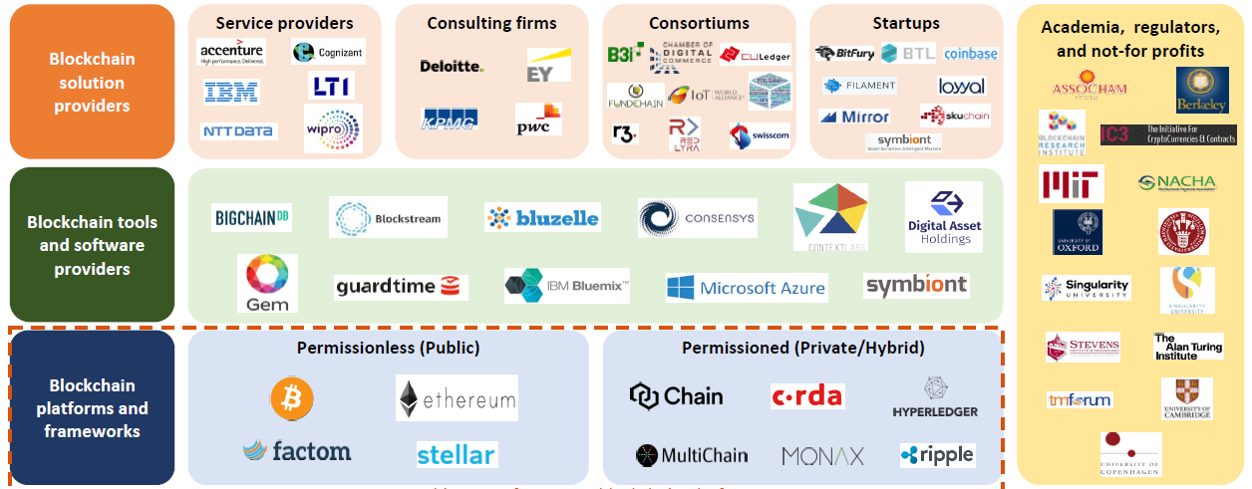
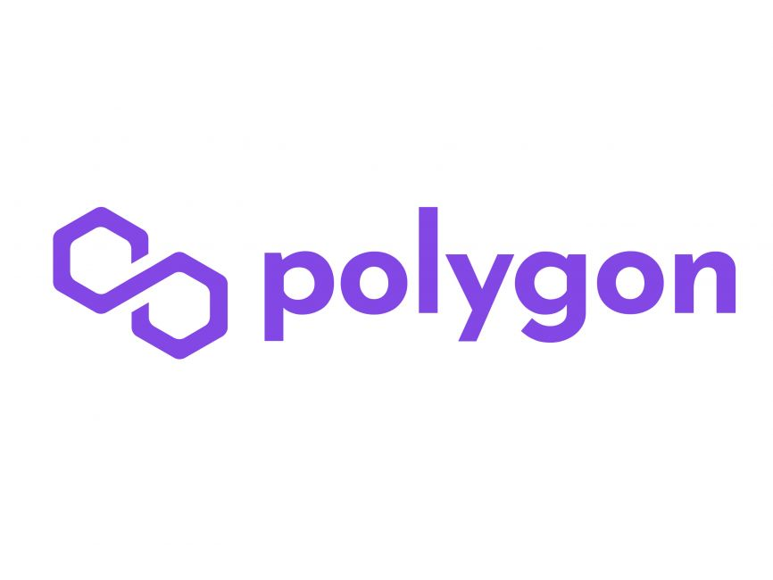
Blockchain ecosystem (bird’s eye view)

